Slide 1

Lesson 5:
Rules for Derivatives

Slide 2


Introduction

Slide 3

Lecture Overview:
Goals of the lecture:
Understand some of the rules for derivatives

Slide 4
Rules for Derivatives

Slide 5
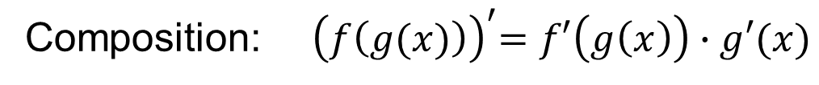
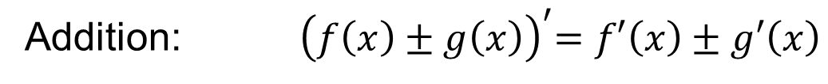
Rules for Derivatives
Definition:
Addition: ${ \left(f\left(x\right)±g\left(x\right)\right)}^{′}=f′\left(x\right)±g′\left(x\right)$
Multiplication: ${\left(f\left(x\right)∙g\left(x\right)\right)}^{′}=f^{′}\left(x\right)∙g\left(x\right)+f(x)∙g′\left(x\right)$
Composition: ${ \left(f\left(g(x)\right)\right)}^{′}=f′\left(g\left(x\right)\right)∙g′(x)$

Slide 6
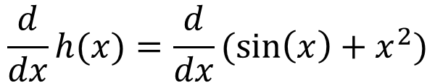

Example for Addition-Subtraction
$${\left(f\left(x\right)±g\left(x\right)\right)}^{′}=f′\left(x\right)±g′\left(x\right)$$
$$\frac{d}{dx}h(x)=\frac{d}{dx}(\sin\left(x\right)+x^{2})$$

Slide 7
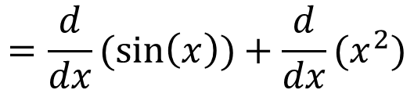
Example for Addition-Subtraction
$${\left(f\left(x\right)±g\left(x\right)\right)}^{′}=f′\left(x\right)±g′\left(x\right)$$
$$\frac{d}{dx}h(x)=\frac{d}{dx}(\sin\left(x\right)+x^{2})$$
$$=\frac{d}{dx}(\sin\left(x\right))+\frac{d}{dx}(x^{2})$$

Slide 8

Example for Addition-Subtraction
$${\left(f\left(x\right)±g\left(x\right)\right)}^{′}=f′\left(x\right)±g′\left(x\right)$$
$$\frac{d}{dx}h(x)=\frac{d}{dx}(\sin\left(x\right)+x^{2})$$
$$=\frac{d}{dx}(\sin\left(x\right))+\frac{d}{dx}(x^{2})$$
$$=\cos\left(x\right)+2x$$

Slide 9
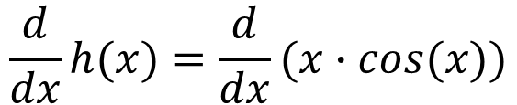
Example for Products
$${\left(f\left(x\right)∙g\left(x\right)\right)}^{′}=f^{′}\left(x\right)∙g\left(x\right)+f(x)∙g′\left(x\right)$$
$$\frac{d}{dx}h(x)=\frac{d}{dx}(x∙cos(x))$$

Slide 10
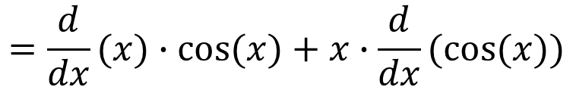
Example for Products
$${\left(f\left(x\right)∙g\left(x\right)\right)}^{′}=f^{′}\left(x\right)∙g\left(x\right)+f(x)∙g′\left(x\right)$$
$$\frac{d}{dx}h(x)=\frac{d}{dx}(x∙cos(x))$$
$$=\frac{d}{dx}(x)∙cos⁡(x)+x∙\frac{d}{dx}(cos⁡(x))$$

Slide 11

Example for Products
$${\left(f\left(x\right)∙g\left(x\right)\right)}^{′}=f^{′}\left(x\right)∙g\left(x\right)+f(x)∙g′\left(x\right)$$
$$\frac{d}{dx}h(x)=\frac{d}{dx}(x∙cos(x))$$
$$=\frac{d}{dx}(x)∙cos⁡(x)+x∙\frac{d}{dx}(cos⁡(x))$$
$$=1∙\cos\left(x\right)−x∙sin⁡(x)$$

Slide 12

Example for Composition (Chain Rule)
$${\left(f\left(g(x)\right)\right)}^{′}=f′\left(g\left(x\right)\right)∙g′(x)$$

Slide 13
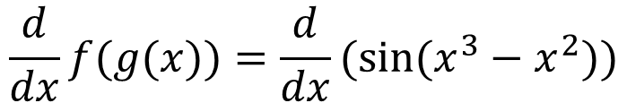
Example for Composition (Chain Rule)
$${\left(f\left(g(x)\right)\right)}^{′}=f′\left(g\left(x\right)\right)∙g′(x)$$
$$\frac{d}{dx}f(g(x))=\frac{d}{dx}(sin⁡(x^{3}−x^{2}))$$

Slide 14
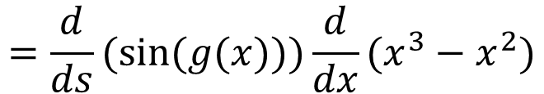
Example for Composition (Chain Rule)
$${\left(f\left(g(x)\right)\right)}^{′}=f′\left(g\left(x\right)\right)∙g′(x)$$
$$\frac{d}{dx}f(g(x))=\frac{d}{dx}(sin⁡(x^{3}−x^{2}))$$
$$=\frac{d}{ds}(sin⁡(g(x)))\frac{d}{dx}(x^{3}−x^{2})$$

Slide 15

Example for Composition (Chain Rule)
$${\left(f\left(g(x)\right)\right)}^{′}=f′\left(g\left(x\right)\right)∙g′(x)$$
$$\frac{d}{dx}f(g(x))=\frac{d}{dx}(sin⁡(x^{3}−x^{2}))$$
$$=\frac{d}{ds}(sin⁡(g(x)))\frac{d}{dx}(x^{3}−x^{2})$$
$$=\cos\left(x^{3}−x^{2}\right)(3x^{2}−2x)$$

Slide 16
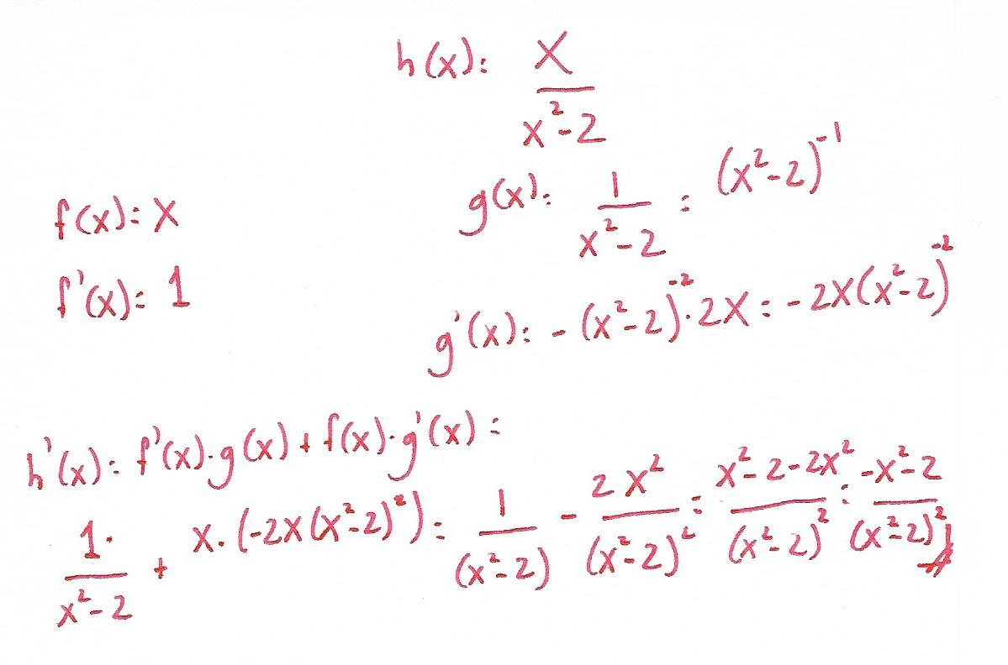
Problem 1:
Problem 1: Calculate h ’(x)

Slide 17
Problem 1:
Problem 1: Calculate h ’(x)

Slide 18
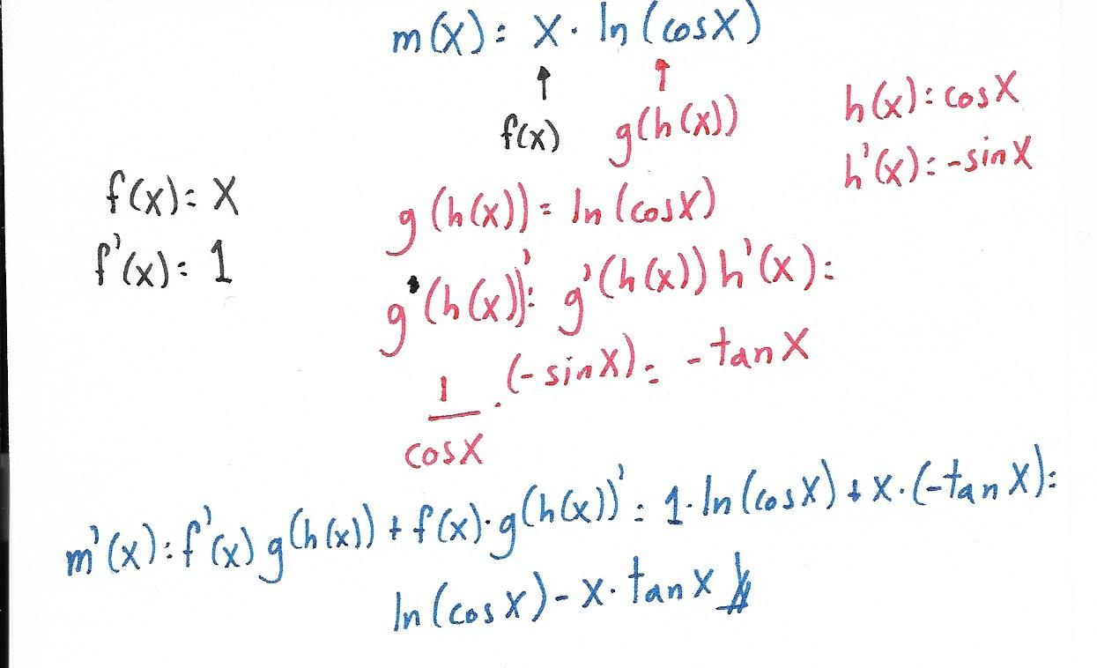
Problem 2:
Problem 2: Calculate m ’(x)

Slide 19
Problem 2:
Problem 2: Calculate m ’(x)

Slide 20
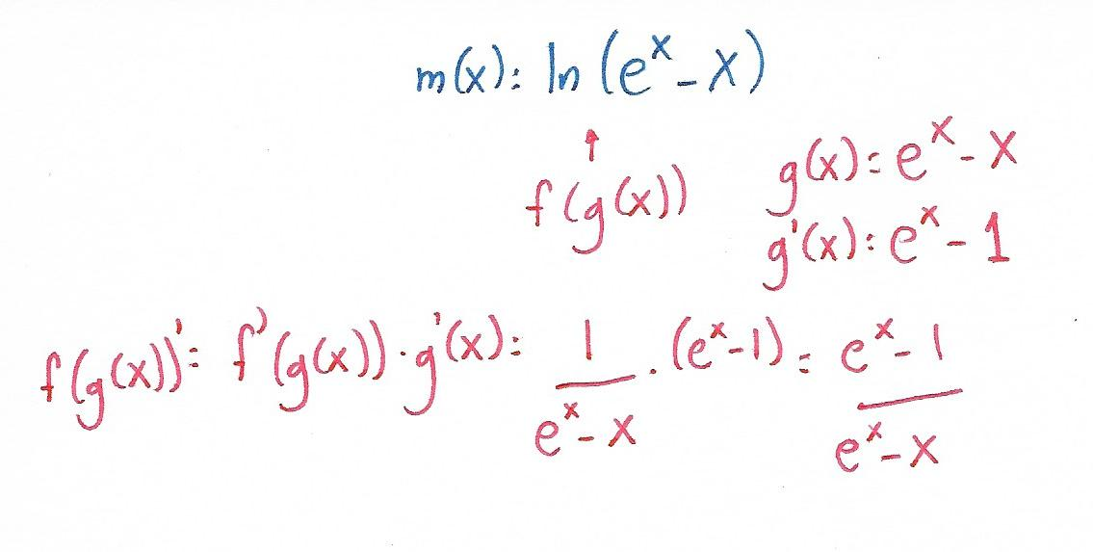
Problem 3:
Problem 3: Calculate m ’(x)

Slide 21
Problem 3:
Problem 3: Calculate m ’(x)

Slide 22
QUESTIONS?

